Slide 1
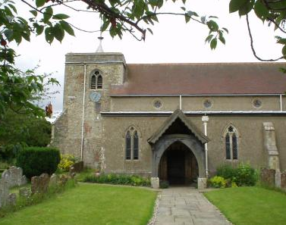
Welcome to the Brill Church Quiz
Saturday 23rd November 2019

Slide 3


Slide 4
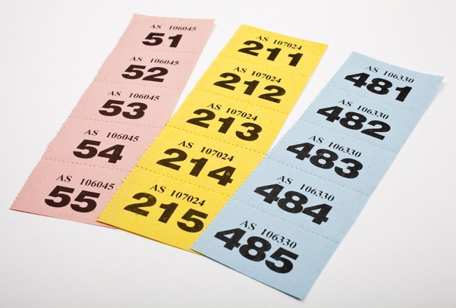
Don’t forget to buy your raffle tickets
Prizes are
Richard Morris-Adams round of golf at Huntercombe & lunch
Majestic scapegrace Gin
Champneys ‘smellies’
Pack of 3 Christmas items
Bottle of Chivas Regal whisky
Bottle of port
½ Bottle of Courvoisier brandy
Bendicks mints
Tickets
£5 per strip
Tickets will be on sale from entry through to the interval
The draw will be made during the interval

Slide 5
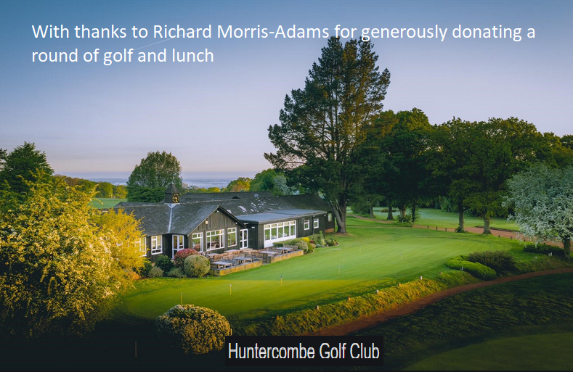


Slide 6

Mobile phones not allowed penalty:- teams lose 50% of their points

Slide 7
Celebrating TV Quiz Shows
A Question of Sport
Only Connect
University Challenge
Sale of the Century
Double your Money
Who Dares Wins
Pointless
Winner Takes All

Slide 8

A Question of Sport
2nd December 1968 – present day

Slide 9
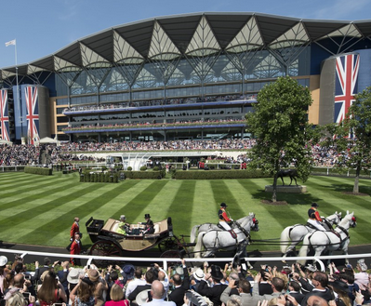
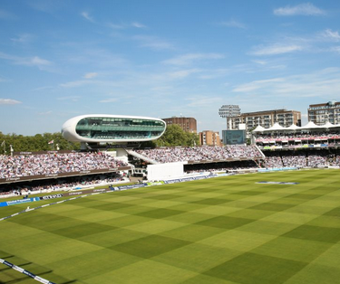
Question of Sport
UK Sporting Venues
5 pts per Venue (Bonus 5 pts for the associated sport)
1 | 2

Slide 10
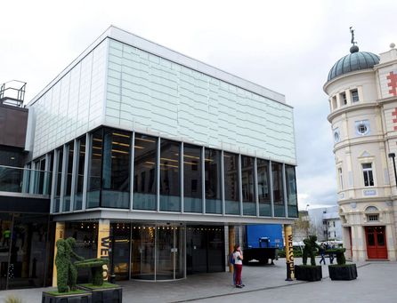
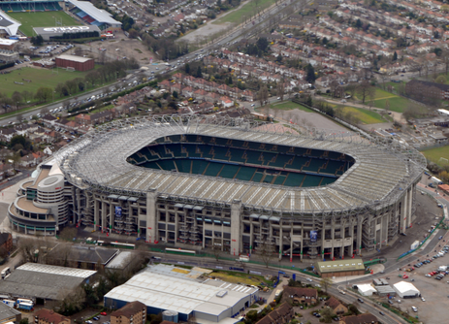
Question of Sport
UK Sporting Venues
5 pts per Venue (Bonus 5 pts for the associated sport)
3 | 4

Slide 11
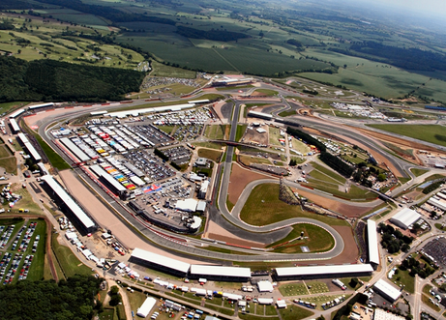
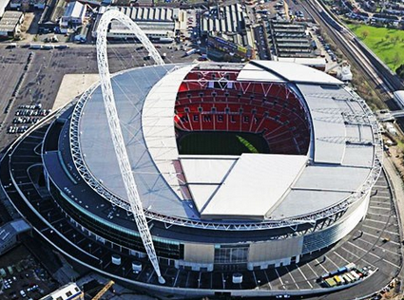
Question of Sport
UK Sporting Venues
5 pts per Venue (Bonus 5 pts for the associated sport)
5 | 6

Slide 12
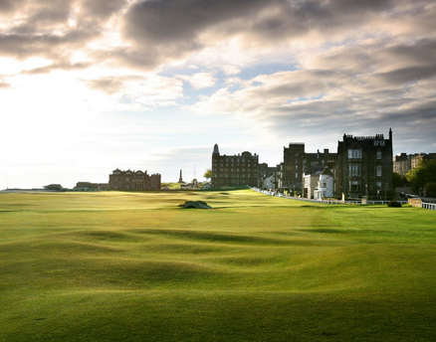
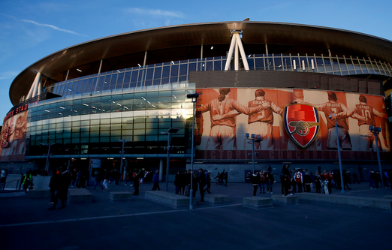
Question of Sport
UK Sporting Venues
5 pts per Venue (Bonus 5 pts for the associated sport)
7 | 8

Slide 13
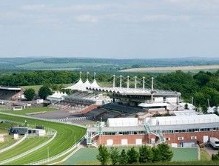
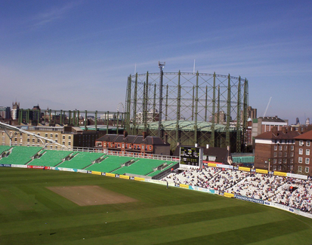
Question of Sport
UK Sporting Venues
5 pts per Venue (Bonus 5 pts for the associated sport)
9 | 10

Slide 14
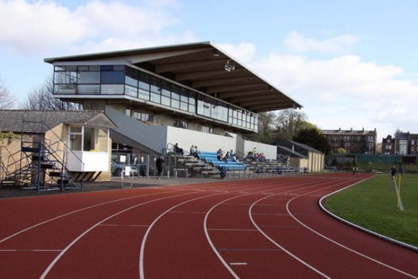
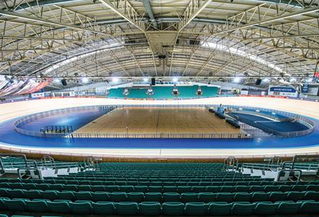
Question of Sport
UK Sporting Venues
5 pts per Venue (Bonus 5 pts for the associated sport)
11 | 12

Slide 15
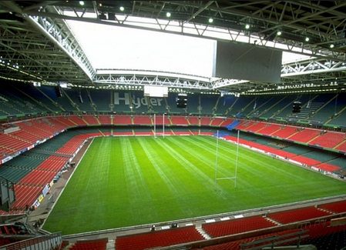
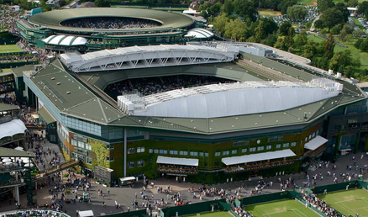
Question of Sport
UK Sporting Venues
5 pts per Venue (Bonus 5 pts for the associated sport)
13 | 14

Slide 16
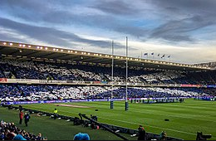
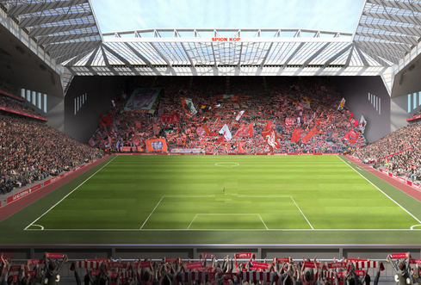
Question of Sport
UK Sporting Venues
5 pts per Venue (Bonus 5 pts for the associated sport)
15 | 16

Slide 17
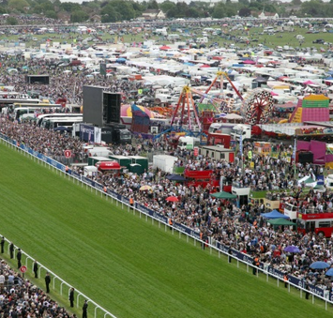
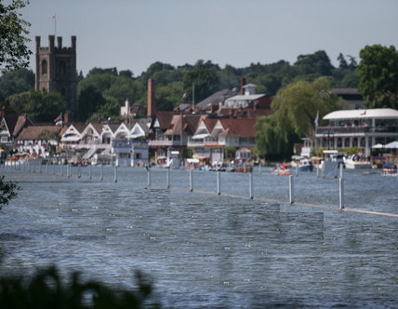
Question of Sport
UK Sporting Venues
5 pts per Venue (Bonus 5 pts for the associated sport)
17 | 18

Slide 18
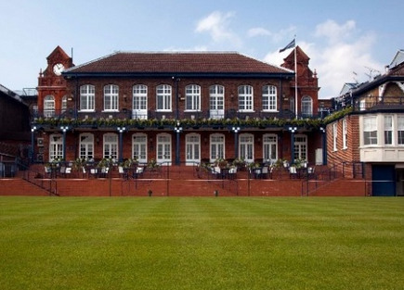
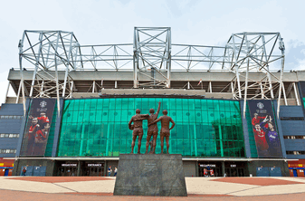
Question of Sport
UK Sporting Venues
5 pts per Venue (Bonus 5 pts for the associated sport)
19 | 20

Slide 19
5 pts per venue (Bonus 5 pts per sport)
1 | Ascot Racecourse | Horse racing | 11 | Iffley Road(Roger Bannister) Stadium | Athletics
2 | Lords | Cricket | 12 | Manchester Veledrome | Cycling
3 | The Crucible | Snooker | 13 | Principality Stadium | Rugby Union
4 | Twickenham | Rugby Union | 14 | Wimbledon | Tennis
5 | Silverstone | Motor Racing | 15 | Murrayfield | Rugby Union
6 | Wembley Stadium | Football | 16 | Anfield | Football
7 | St Andrews | Golf | 17 | Epsom Racecourse | Horse racing
8 | Emirates Stadium | Football | 18 | Henley | Rowing
9 | Goodwood Racecourse | Horse racing | 19 | Queens Club | Tennis
10 | The Oval | Cricket | 20 | Old Trafford | Football

Slide 20
Pay or play?
Your ticket entitles you to supper and the full quiz. Gold, Silver and Bronze medals are awarded to the first 3 teams, with 8 bottles of wine, kindly donated by Constables, to the winners.
However, the event seeks to raise funds for Brill Church, so for Rounds 2-7 each team can choose to pay for a ‘Joker’ at £1 per team member, which gives them the chance to win the sponsors prize and gain double points for the round.

Slide 21
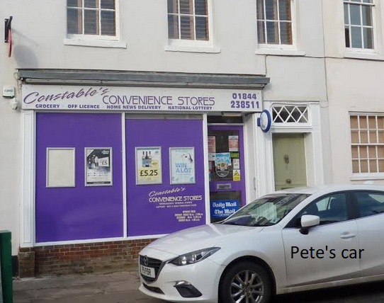
We are very grateful to Constables for their generous sponsorship

Slide 22
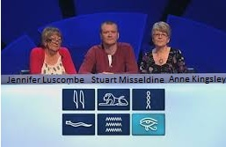
Only Connect
15th September 2008 – present
Pay or play?

Slide 23
The Royal Wall generously sponsored by Brill Stores and Mahesh
Monarch | Reign | Spouse | Offspring | Prime Minister
Edward VII | 1820-1830 | Adelaide | Beatrice | Arthur Balfour
George IV | 1830-1837 | Albert | Charlotte | Earl Grey
William IV | 1837-1901 | Alexandra | Elizabeth | George Canning
Victoria | 1901-1910 | Caroline | Maud | Viscount Palmerston

Slide 24
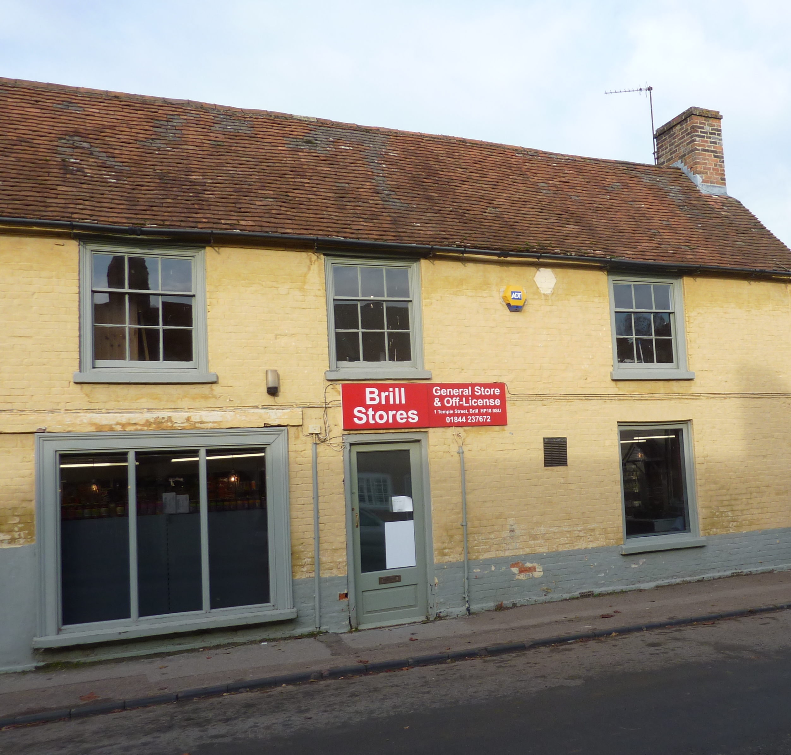
The Royal Wall generously sponsored by Brill Stores
4 lines to complete
2 correct in a line scores 20 pts
3 correct in a line scores 40 pts
4 correct in a line scores 60 pts
A fully correct line scores 100 pts
Maximum score for a fully completed wall 400 pts

Slide 25
The Royal Wall generously sponsored by Brill Stores
Monarch | Reign | Spouse | Offspring | Prime Minister
Edward VII
George IV
William IV
Victoria

Slide 26
The Royal Wall
Let thinking time commence

Slide 27
The Royal Wall generously sponsored by Brill Stores
Monarch | Reign | Spouse | Offspring | Prime Minister
Edward VII | 1820-1830 | Adelaide | Beatrice | Arthur Balfour
George IV | 1830-1837 | Albert | Charlotte | Earl Grey
William IV | 1837-1901 | Alexandra | Elizabeth | George Canning
Victoria | 1901-1910 | Caroline | Maud | Viscount Palmerston

Slide 28
The Royal Wall generously sponsored by Brill Stores
Monarch | Reign | Spouse | Offspring | Prime Minister
Edward VII | 1901-1910 | Alexandra | Maud | Arthur Balfour
George IV | 1820-1830 | Caroline | Charlotte | George Canning
William IV | 1830-1837 | Adelaide | Elizabeth | Earl Grey
Victoria | 1837-1901 | Albert | Beatrice | Viscount Palmerston

Slide 29
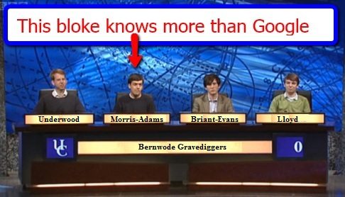
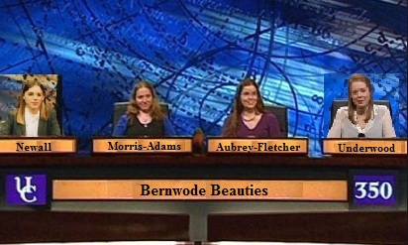
University Challenge
1962-1987 & 1994- present pay or play?

Slide 30
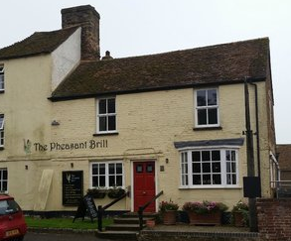
Generously sponsored by The Pheasant:
Sunday lunch for 2 with wine

Slide 31
University Challenge
Kindly sponsored by The Pheasant
Students drink; this is your starter for 10 drinks
What are the ingredients of each of these cocktails?
30 pts per correctly assigned ingredient
Bellini |  |  | xxxxx | xxxxx | xxxxx
Bloody Mary |  |  | xxxxx | xxxxx | xxxxx
Bucks Fizz |  |  | xxxxx | xxxxx | xxxxx
Manhattan |  |  |  | xxxxx | xxxxx
Mojito
Negroni |  |  |  | xxxxx | xxxxx
Pina Colada |  |  |  | xxxxx | xxxxx
Sex on the Beach |  |  |  |  | xxxxx
Sidecar |  |  |  | xxxxx | xxxxx
White Russian |  |  |  | xxxxx | xxxxx

Slide 32
John Wilkins & John Slusar’s Cocktail Bar
‘The Two Johnnies’
Angostura bitters | Lemon | Red Vermouth
Brandy | Lime juice | Rye Whisky
Campari | Mint | Soda
Cane Sugar | Orange juice | Tomato Juice
Champagne | Orange juice | Triple Sec
Coconut cream | Peach nectar | Vodka
Cranberry juice | Peach Schnapps | Vodka
Cream | Pineapple juice | Vodka
Gin | Prosecco | White Rum
Kahlua | Red Vermouth | White Rum

Slide 33
University Challenge
Kindly sponsored by The Pheasant
Students drink; this is your starter for 10 drinks
What are the ingredients of each of these cocktails?
30 pts per correctly assigned ingredient
Bellini | Peach Nectar | Prosecco | xxxxx | xxxxx | xxxxx
Bloody Mary | Tomato juice | Vodka | xxxxx | xxxxx | xxxxx
Bucks Fizz | Champagne | Orange juice | xxxxx | xxxxx | xxxxx
Manhattan | Anger bitters | Red Vermouth | Rye Whisky | xxxxx | xxxxx
Mojito | Cane sugar | Lime juice | White Rum | Soda | Mint
Negroni | Campari | Gin | Red Vermouth | xxxxx | xxxxx
Pina Colada | White Rum | Pineapple juice | Coconut cream | xxxxx | xxxxx
Sex on the Beach | Orange juice | Cranberry juice | Peach Schnapps | Vodka | xxxxx
Sidecar | Brandy | Lemon | Triple Sec | xxxxx | xxxxx
White Russian | Cream | Kahlua | Vodka | xxxxx | xxxxx

Slide 34

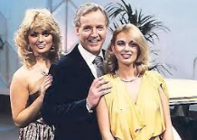
Sale of the Century
1972 – 1983
Pay or Play?

Slide 35

Sale of the Century sponsored by Darren The Fish
(£25 voucher)
Winners share 1000 pts
4th Round losers 250 pts
3rd Round losers 120 pts
2nd Round losers 80 pts
First Round losers 40 pts

Slide 36
John Lewis
Never knowingly undersold
All items are taken from the current John Lewis online catalogue
They are typical items used from daybreak to nightfall.
You have a choice of 3 prices each round.

Slide 37
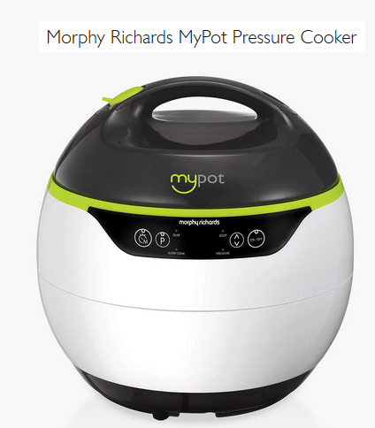
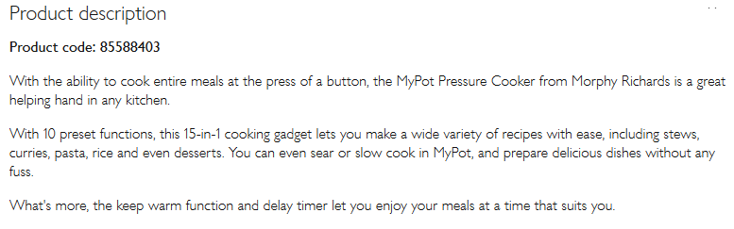
Sale of the century
Didn’t look like this in my day
A Less than £40
B £40
C More than £40

Slide 38
Pressure cooker
C £59.99
Losers get 40 pts

Slide 39
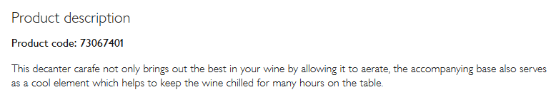
Sale of the Century
A Less Than £99.99
B £99.99
C More than £99.99

Slide 40
Carafe cooler
A £85
Losers get 80 pts

Slide 41
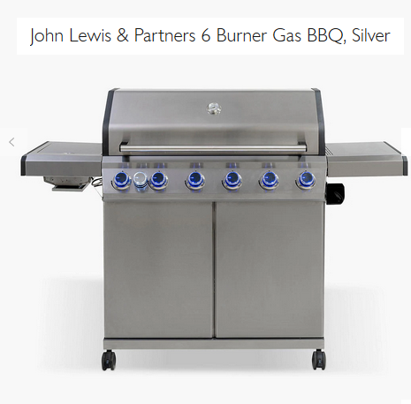
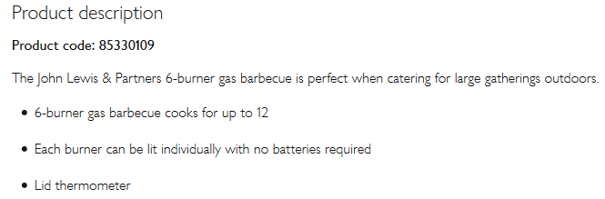
Sale of the Century
A Less than £600
B £600
C More than £600

Slide 42
Gas Barbecue
C £699.00
Losers get 120 pts

Slide 43
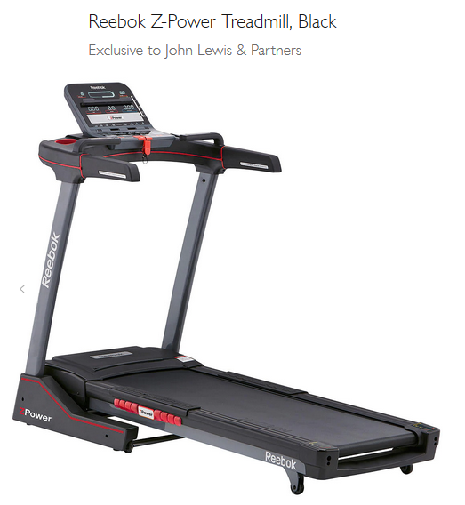
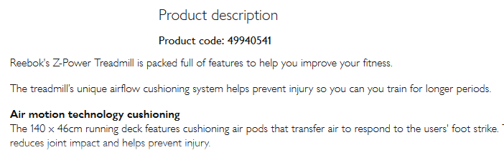
Sale of the Century
A Less than £850
B £850
C More than £850

Slide 44
Treadmill
A £799
Losers get 250 pts
Winners share 1000 pts

Slide 45
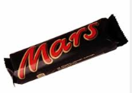
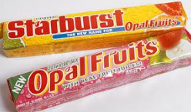

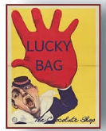
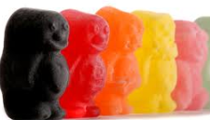

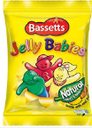
Half way through the show
Lucky

Slide 46
Don’t forget to buy your raffle tickets
Prizes are
Richard Morris-Adams round of golf at Huntercombe & lunch
Majestic scapegrace Gin
Champneys ‘smellies’
Pack of 3 Christmas items
Bottle of Chivas Regal whisky
Bottle of port
½ Bottle of Courvoisier brandy
Bendicks mints
Tickets
£5 per strip
Tickets will be on sale from entry through to the interval
The draw will be made during the interval

Slide 47
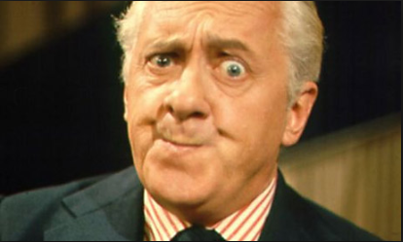
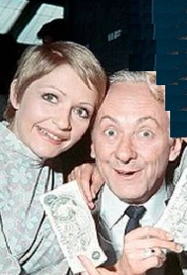
Double Your Money
1955 – 1968 (Pay or Play?)
Hughie Green
Monica Rose & Hughie Green

Slide 48
Double Your Money sponsored by Velvet Brown
Win from 20pts to 2,560 pts
All questions relate to Pop Icons & Idols
Answer 8 questions correctly to win 2,560 pts
You can quit whenever you like to claim your points before the next question is asked.

Slide 49
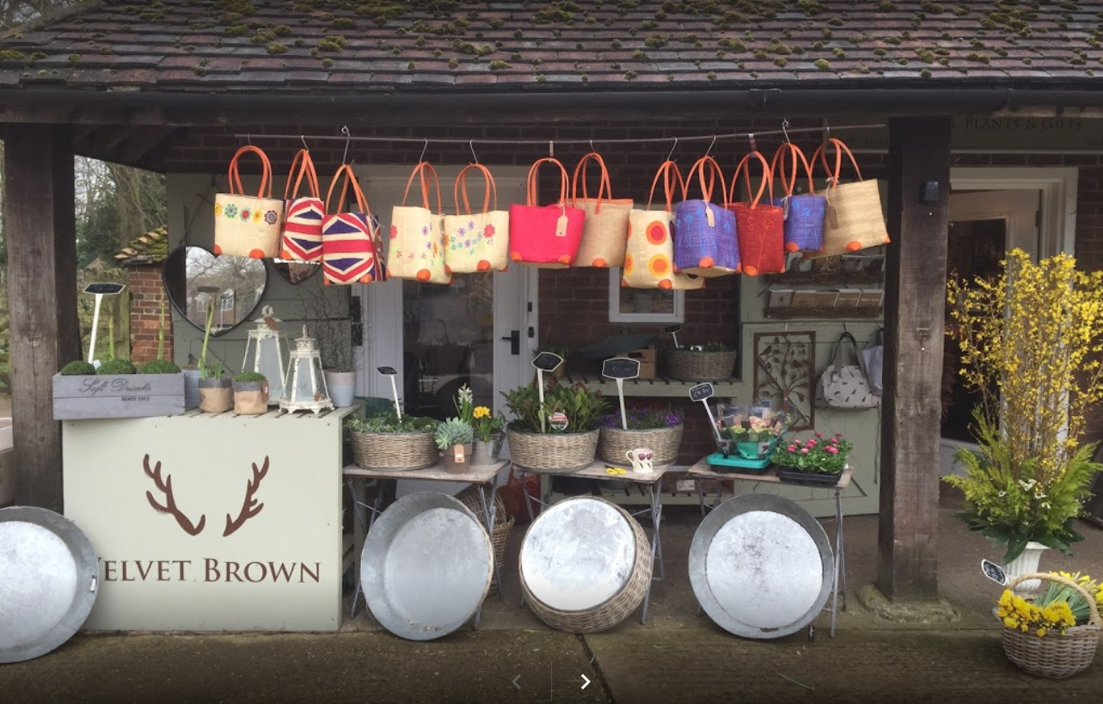
We are very grateful to Velvet Brown (4 small arrangements) for their generous sponsorship

Slide 50
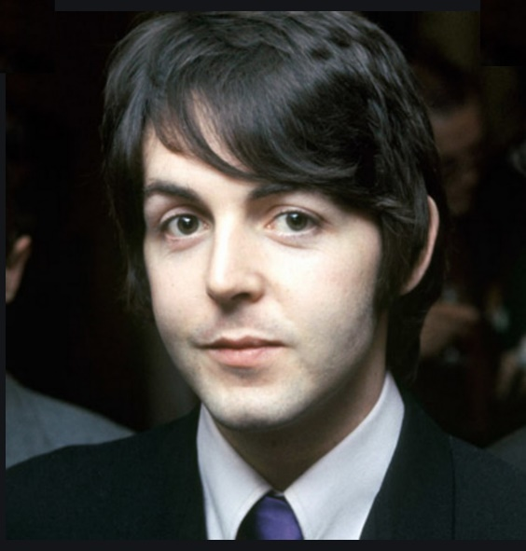
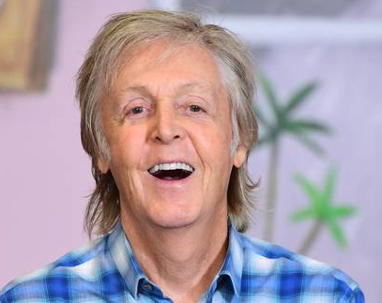
For 20 points
Who is this?

Slide 51
Paul McCartney
Double or Quits?

Slide 52

For 40 points
Who is this?

Slide 53
Ariana Grande
Double or Quits?

Slide 54
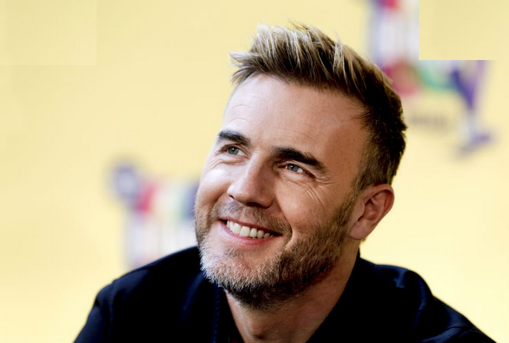
For 80 points
Who is this?

Slide 55
Gary Barlow
Double or Quits?

Slide 56
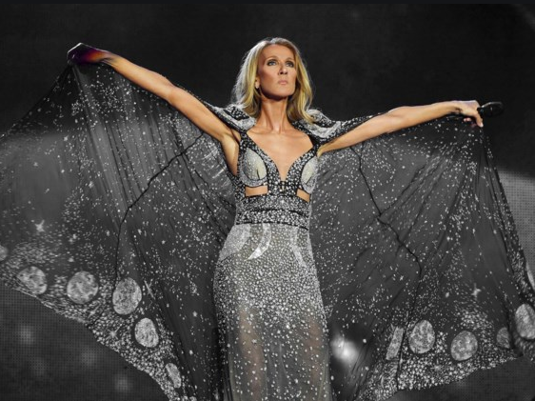
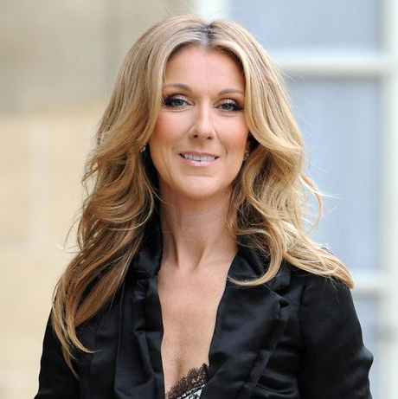
For 160 points
Who is this?

Slide 57
Celine Dion
Double or Quits?

Slide 58

For 320 points
Who is this?

Slide 59
Bob Dylan
Double or Quits?

Slide 60


For 640 points
Who is this?

Slide 61
Billy Joel
Double or Quits?

Slide 62


For 1,280 points
Who is this?

Slide 63
Avril Lavigne
Double or Quits?

Slide 64


For 2,560 points
Who is this?

Slide 65
Nena
Did you hit the jackpot?

Slide 66

Who Dares Wins
17th November 2007 - present
Pay or play?

Slide 67
Generously sponsored by The Pointer, Brill with a £50 voucher

Slide 68
Who Dares Wins sponsored by The Pointer (£50 voucher)
The table contains 15 triplets. Your aim is to identify the African country in each triplet which is landlocked. How far can your team climb without going wrong?
3 correct = 100 pts
6 correct = 200 pts
9 correct = 400 pts
11 correct = 800 pts
13 correct = 1200 pts
All 15 correct = 2000 pts

Slide 69
Who Dares Wins
2000 | Algeria | Mali | Mauritania
 | Egypt | Guinea | Niger
1500 | Guinea Bissau | Tunisia | Zambia
 | Djibouti | Ethiopia | Somalia
800 | Cameroon | Chad | Libya
 | Benin | Burkina Faso | Togo
400 | Eswatini | Gabon | Morocco
 | Burundi | DR Congo | Tanzania
 | Equatorial Guinea | Ghana | Uganda
200 | Senegal | The Gambia | Zimbabwe
 | Liberia | Rwanda | Tunisia
 | Angola | Malawi | Sierra Leone
100 | Botswana | Mozambique | Namibia
 | Kenya | South Sudan | Sudan
 | Eritrea | Lesotho | South Africa

Slide 70
Who Dares Wins
Let the thinking commence

Slide 71
Who Dares Wins
2000 | Algeria | Mali | Mauritania
 | Egypt | Guinea | Niger
1500 | Guinea Bissau | Tunisia | Zambia
 | Djibouti | Ethiopia | Somalia
800 | Cameroon | Chad | Libya
 | Benin | Burkina Faso | Togo
400 | Eswatini | Gabon | Morocco
 | Burundi | DR Congo | Tanzania
 | Equatorial Guinea | Ghana | Uganda
200 | Senegal | The Gambia | Zimbabwe
 | Liberia | Rwanda | Tunisia
 | Angola | Malawi | Sierra Leone
100 | Botswana | Mozambique | Namibia
 | Kenya | South Sudan | Sudan
 | Eritrea | Lesotho | South Africa

Slide 72

Pointless
24th August 2009 – present
Pay or play?

Slide 73


Generously sponsored by
John & Anna Wilkins Butchers
A demonstration of how to butcher a lamb, with the winners sharing the meat afterwards.

Slide 74
Word Round
Think of a word in the Oxford English Dictionary ending in
BOX
The longer, more obscure your word the more points you will score.
Points from 50 to 2000 are available.

Slide 75
The Points Board (part 1)
BANDBOX | 200 | EMBOX | 550
BEATBOX | 150 | FAREBOX | 1000
BOOMBOX | 300 | FEEDBOX | 900
BRAINBOX | 500 | FIREBOX | 1200
BREADBOX | 600 | GEARBOX | 80
CAKEBOX | 100 | GOGGLEBOX | 2000
CASHBOX | 220 | HATBOX | 100
CHATTERBOX | 1700 | HAYBOX | 800
CLACKBOX | 400 | HELLBOX | 300
CLANGBOX | 450 | HOMEOBOX | 1000
COALBOX | 1100 | HOMOEOBOX | 1100
ECONOBOX | 650 | HORSEBOX | 1000

Slide 76
The Points Board (part 2)
HOTBOX | 900 | MATCHBOX | 50
ICEBOX | 90 | OUTBOX | 850
INBOX | 800 | PAINTBOX | 60
JAWBOX | 1000 | PEGBOX | 750
JUKEBOX | 1500 | PEPPERBOX | 1600
KICKBOX | 2000 | PILLBOX | 70
LETTERBOX | 120 | POSTBOX | 80
LISTBOX | 1700 | PRATTLEBOX | 1000
LOCKBOX | 1600 | RATTLEBOX | 900
LOOSEBOX | 1200 | SALTBOX | 350
LUNCHBOX | 140 | SANDBOX | 1300
MAILBOX | 600 | SAUCEBOX | 1200

Slide 77
The Points Board (part 3)
SEEDBOX | 300 | TEABOX | 400
SHADOWBOX | 1500 | THUNDERBOX | 700
SHOEBOX | 250 | TINDERBOX | 2000
SHOWBOX | 1000 | TOOLBOX | 180
SKYBOX | 1100 | TUCKERBOX | 1900
SNUFFBOX | 800 | UNBOX | 950
SOAPBOX | 350 | WATCHBOX | 1400
SOUNBOX | 550 | WOODBOX | 1500
SQUEEZEBOX | 1800 | WORKBOX | 160
STRONGBOX | 450
SWEATBOX | 500
TALKBOX | 600

Slide 78

Winner Takes All
1975 – 1988

Slide 79
7) Who is Emilie Charlotte Le Breton better known as?
A | Lillie Langtry
B | Coco Chanel
C | Marlene Dietrich
D | Emeli Sande
E | Mata Hari

Slide 80
7) Who is Emilie Charlotte Le Breton better known as?
A | Lillie Langtry
B | Coco Chanel (Gabrielle Bonheur Chanel)
C | Marlene Dietrich (Marie Magdalene Dietrich)
D | Emeli Sande (Adele Emily Sande)
E | Mata Hari (Margaretha Geertruida Macleod)

Slide 81
6) What is the TOTAL number of letters in the titles of these Dickens books?
M… C………
D… C……
A C…… C…….
T.. P… P…
L.. D…
A | 75
B | 76
C | 77
D | 78
E | None of these

Slide 82
6) What is the TOTAL number of letters in the titles of these Dickens books?
MARTIN CHUZZLEWIT 16
DAVID COPPERFIELD 16
A CHRISTMAS CAROL 15
THE PICKWICK PAPERS 17
LITTLE DORRIT 12
A | 75
B | 76
C | 77
D | 78
E | None of these

Slide 83





5) Which of the 6 wives of Henry VIII is shown below in the middle?
A | Ann of Cleeves
B | Catherine of Aragon
C | Catherine Parr
D | Catherine Howard
E | Ann Boleyn

Slide 84




5) Which of the 6 wives of Henry VIII is shown below in the middle?
A | Ann of Cleeves
B | Catherine of Aragon
C | Catherine Parr
D | Catherine Howard
E | Ann Boleyn

Slide 85
4) When Novak Djokovic defeated Roger Federer in the longest Wimbledon final in the modern era the score was 7/6 1/6 7/6 4/6 13/12
How many balls (not sets of balls) were used?
A | 42
B | 48
C | 54
D | 63
E | 72

Slide 86
4) When Novak Djokovic defeated Roger Federer in the longest Wimbledon final in the modern era the score was 7/6 1/6 7/6 4/6 13/12
How many balls (not sets of balls) were used?
A | 42
B | 48 (8 sets of 6 balls)
C | 54
D | 63
E | 72

Slide 87
3) If these politicians were placed in age order, who would be in the middle?
A | Boris Johnson
B | Nicola Sturgeon
C | Jo Swinson
D | Jeremy Corbyn
E | Nigel Farage

Slide 88
3) If these politicians were placed in age order, who would be in the middle?
A | Boris Johnson (19/6/1964)
B | Nicola Sturgeon (19/7/1970)
C | Jo Swinson (5/2/1980)
D | Jeremy Corbyn (26/5/1949)
E | Nigel Farage (3/4/1964)

Slide 89

2) What is the scientific name for red hot pokers?

Slide 90
2) What is the scientific name for red hot pokers?
A | Knifofia
B | Knifophia
C | Kniphophia
D | Niphofia
E | Kniphofia

Slide 91
2) What is the scientific name for red hot pokers?
A | Knifofia
B | Knifophia
C | Kniphophia
D | Niphofia
E | Kniphofia

Slide 92
1) How many different consonants are there in the immortal first 11 words by Neil Armstrong when landing on the moon? It’s the version beginning ‘Th…..’
A | 10
B | 11
C | 12
D | 13
E | None of these

Slide 93
1) How many different consonants are there in the immortal first 11 words by Neil Armstrong when landing on the moon?
That’s one small step for man, one giant leap for mankind
A | 10
B | 11
C | 12
D | 13
E | None of these

Slide 94
That’s all folks!
The quiz is now online at
www.greyhoundderby.com
Scroll down to QUIZ 14

